Slide 1

Seidu Suleiman
Data Analytics Intern at Oasis Infobyte

Slide 2
Data Cleaning Process for NYC Airbnb Dataset
Task 3
Preparing Data for Reliable Analysis

Slide 3
Introduction
1. What is Data Cleaning?
Data Cleaning is the process of fixing or removing incorrect, corrupted, incorrectly formatted, duplicated or incomplete data within a dataset.
Data cleaning is crucial in data analysis because it ensures the quality and accuracy of the data, which is essential for making reliable decisions and predictions.
2. Objective:
Ensure data integrity, consistency, and reliability.
Prepare the Airbnb dataset for meaningful insights.

Slide 4
Dataset Overview
1. Source:
NYC Airbnb 2019 dataset.
2. Key Features:
Examples: price, room_type, neighbourhood, availability_365.
3. Initial Observations:
Presence of missing values.
Duplicate rows.
Outliers in price and minimum nights.

Slide 5
Handling Missing Values
1. Problem:
Missing data in columns: name, host_name, reviews_per_month, last_review.
2. Solution:
Replace missing text values with "Unknown."
Fill reviews_per_month with 0.
Convert last_review to datetime format.
3. Result:
Reduced missing values significantly.

Slide 6
Removing Duplicate Rows
1. Problem:
Duplicates distort analysis by repeating data points.
2. Solution:
Removed all duplicate rows.
3. Result:
Removed duplicate rows making dataset reduced significantly.

Slide 7
Outlier Removal
1. Problem:
Extreme values in price (e.g., $10,000) and minimum_nights (e.g., 1000 days).
2. Solution:
Set thresholds:
Price: Keep rows where price <= 1000.
Minimum Nights: Keep rows where minimum_nights < 365.
3. Result:
Removed unrealistic values, improving data quality.

Slide 8
Standardizing Text
1. Problem:
Inconsistent text (e.g., mixed casing, extra spaces) in columns like host_name, neighbourhood.
2. Solution:
Converted all text to lowercase.
Stripped extra spaces.
3. Result:
Cleaner, uniform text for better analysis.

Slide 9
Standardizing Text
1. Problem:
Inconsistent text (e.g., mixed casing, extra spaces) in columns like host_name, neighbourhood.
2. Solution:
Converted all text to lowercase.
Stripped extra spaces.
3. Result:
Cleaner, uniform text for better analysis.

Slide 10
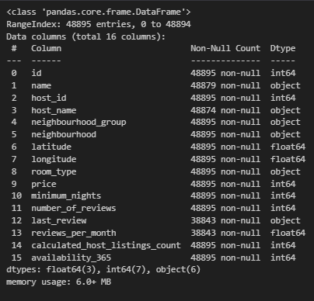
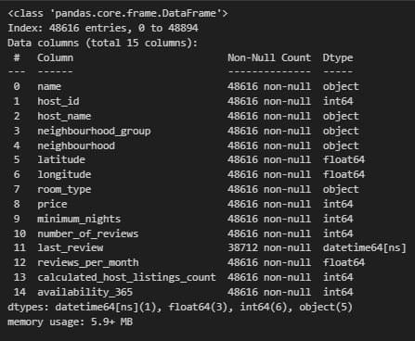
Before vs. After
Before
Before Cleaning:
Rows: 48,895
Columns: 16
Missing Values: Multiple columns
Outliers: Present
After Cleaning:
Rows: 48,616
Columns: 15
Missing Values: Minimal
Outliers: Removed.
After

Slide 11
Key Takeaways
1. Learnings:
How to handle missing values.
Identifying and removing duplicates and outliers.
Standardizing data for consistency.
2. Outcome:
A clean dataset ready for reliable analysis.

Slide 12
Thank
You!

Slide 13
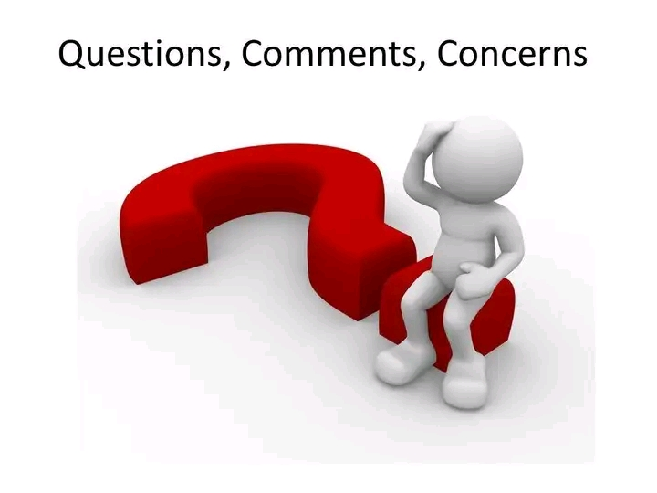
Let me know!
Email
seidusuleiman0@gmail.com
Linkedin
https://www.linkedin.com/in/suleiman-seidu-8b2135343

